Slide 1
Black Box Testing Boundary Value Analysis
Prepared by Chala Urgessa

Slide 2
Boundary Value Analysis (BVA)
This method leads to a selection of test cases that exercise boundary values. It complements equivalence partitioning since it selects test cases at the edges of a class. Rather than focusing on input conditions solely, BVA derives test cases from the output domain also.
Characteristics:
Large number of errors tend to occur at boundaries of the input domain.
BVA leads to selection of test cases that exercise boundary values.
BVA complements equivalence partitioning. Rather than select any element in an equivalence class, select those at the ''edge' of the class.

Slide 3
Boundary Value Analysis
Boundary Value Analysis Guidelines
For input ranges bounded by a and b, test cases should include values a and b and just above and just below a and b respectively.
If an input condition specifies a number of values, test cases should be developed to exercise the minimum and maximum numbers and values just above and below these limits.
Apply guidelines 1 and 2 to the output.
If internal data structures have prescribed boundaries, a test case should be designed to exercise the data structure at its boundary.

Slide 4
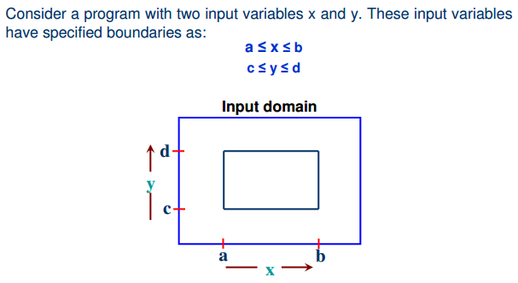
Boundary Value Analysis

Slide 5
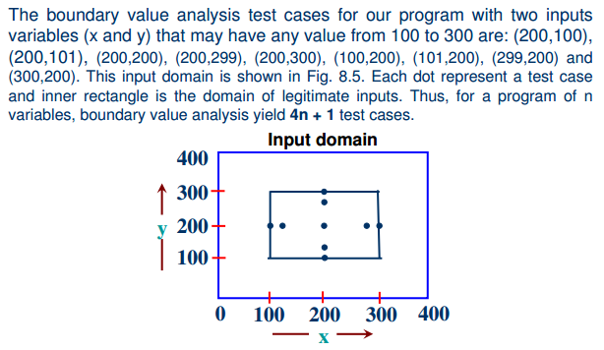
Boundary Value Analysis

Slide 6
Example 3.4
Consider the program for the determination of the nature of roots of a quadratic equation as explained in example 3.1. Design the boundary value test cases.

Slide 7
Solution
Quadratic equation will be of type:
ax²+bx+c=0
Roots are real if (b²-4ac)>0
Roots are imaginary if (b²-4ac)<0
Roots are equal if (b²-4ac)=0
The equation is not quadratic if a=0

Slide 8
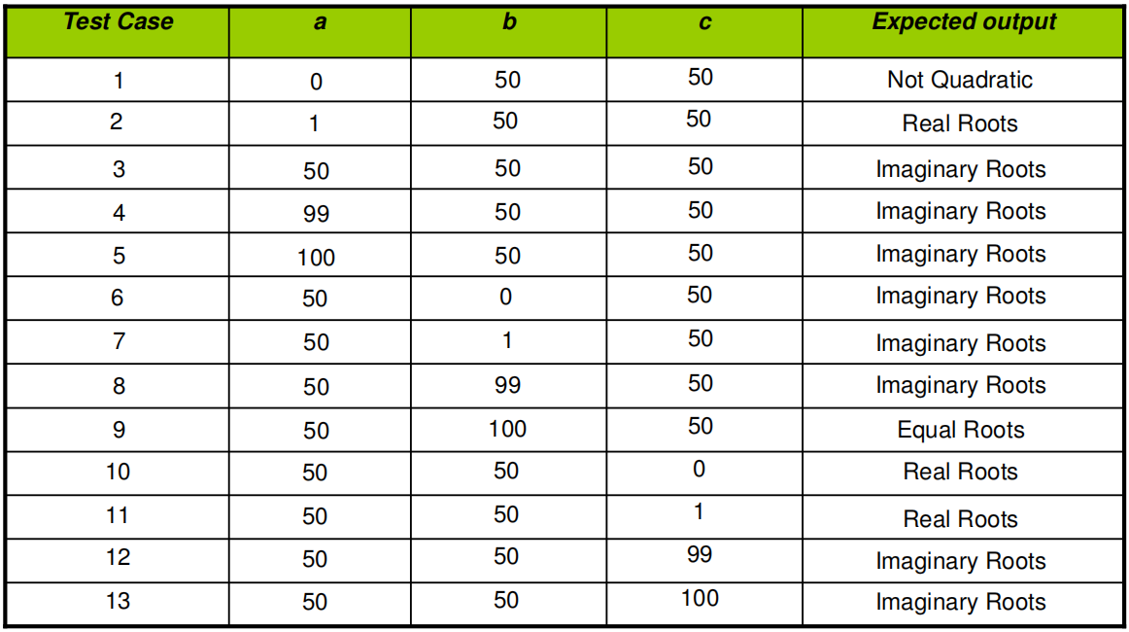
Solution (cont...)
The boundary value test cases are :

Slide 9
Example 3.5: Class Activity
Consider the program for the determination of the previous date in a calendar as explained in example 3.3. Design the boundary value test cases.

Slide 10
Solution
The Previous date program takes a date as input and checks it for validity. If valid, it returns the previous date as its output.
With single fault assumption theory, 4n+1 test cases can be designed and which are equal to 13.

Slide 11
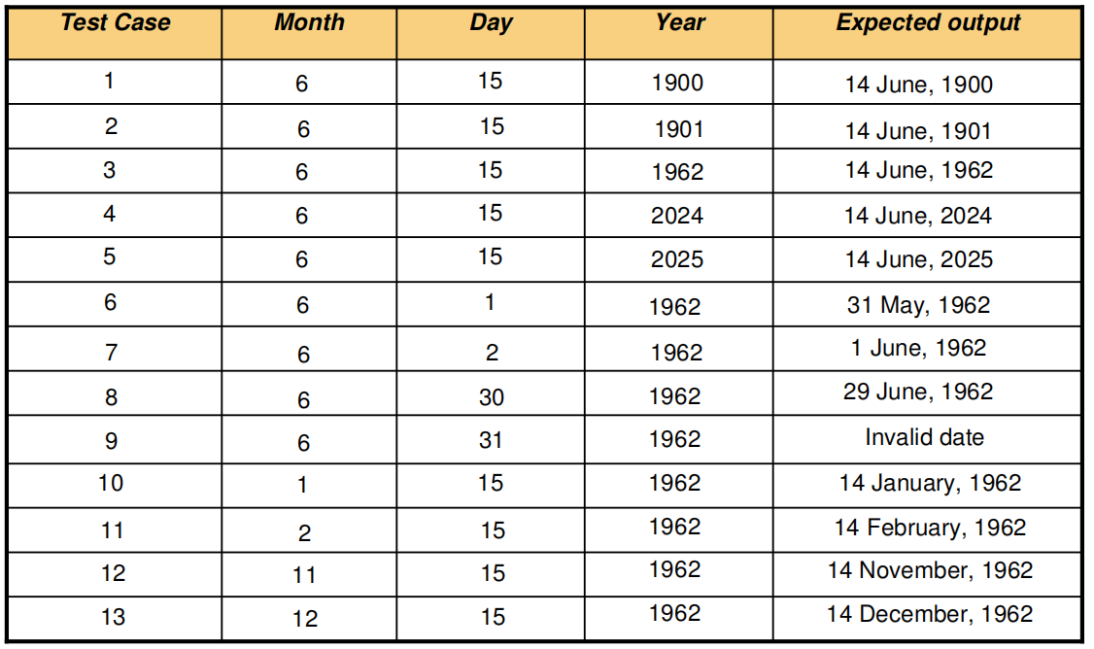
Cont ...
The boundary value test cases are:

Slide 12
Robustness Testing
It is nothing but an extension of boundary value analysis. Here, we would like to see, what happens when the extreme values are exceeded with a value slightly greater than the maximum, and a value slightly less than the minimum.
It means, we want to go outside the legitimate boundary of the input domain. This extended form of boundary value analysis is called robustness testing and is shown in the next slide.

Slide 13
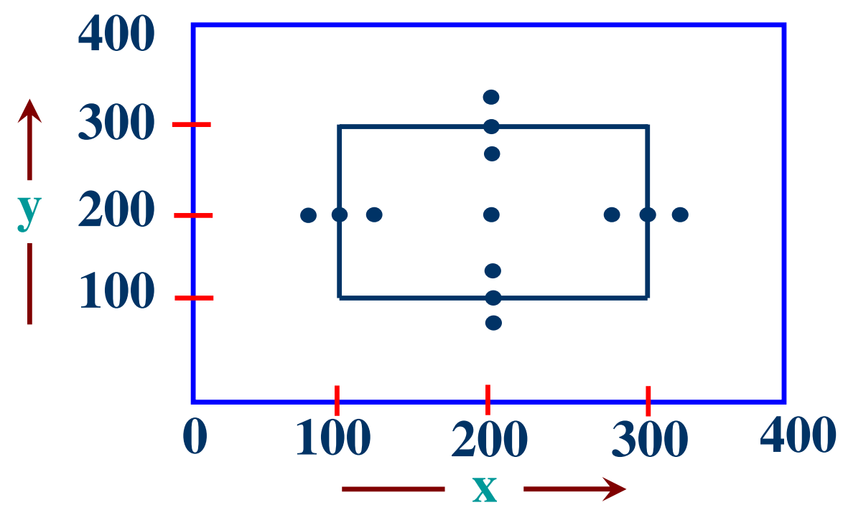
BVA Robustness Testing
There are four additional test cases which are outside the legitimate input
domain. Hence total test cases in robustness testing are 6n+1, where n is
the number of input variables. So, 13 test cases are:
(200,99), (200,100), (200,101), (200,200), (200,299), (200,300)
(200,301), (99,200), (100,200), (101,200), (299,200), (300,200), (301,200)
Robustness test cases for two variables x and y with range [100, 300] each

Slide 14
Worst-case testing
If we reject “single fault” assumption theory of reliability and may like to see what happens when more than one variable has an extreme value. In electronic circuits analysis, this is called “worst-case analysis”.
It is more thorough in the sense that boundary value test cases are a proper subset of worst-case test cases. It requires more effort. Worst-case testing for a function of n variables generates 5n test cases as opposed to 4n+1 test cases for BVA.
Our two variables example will have 5^{n}=25 test cases and are given in the table as shown in the next slide.

Slide 15
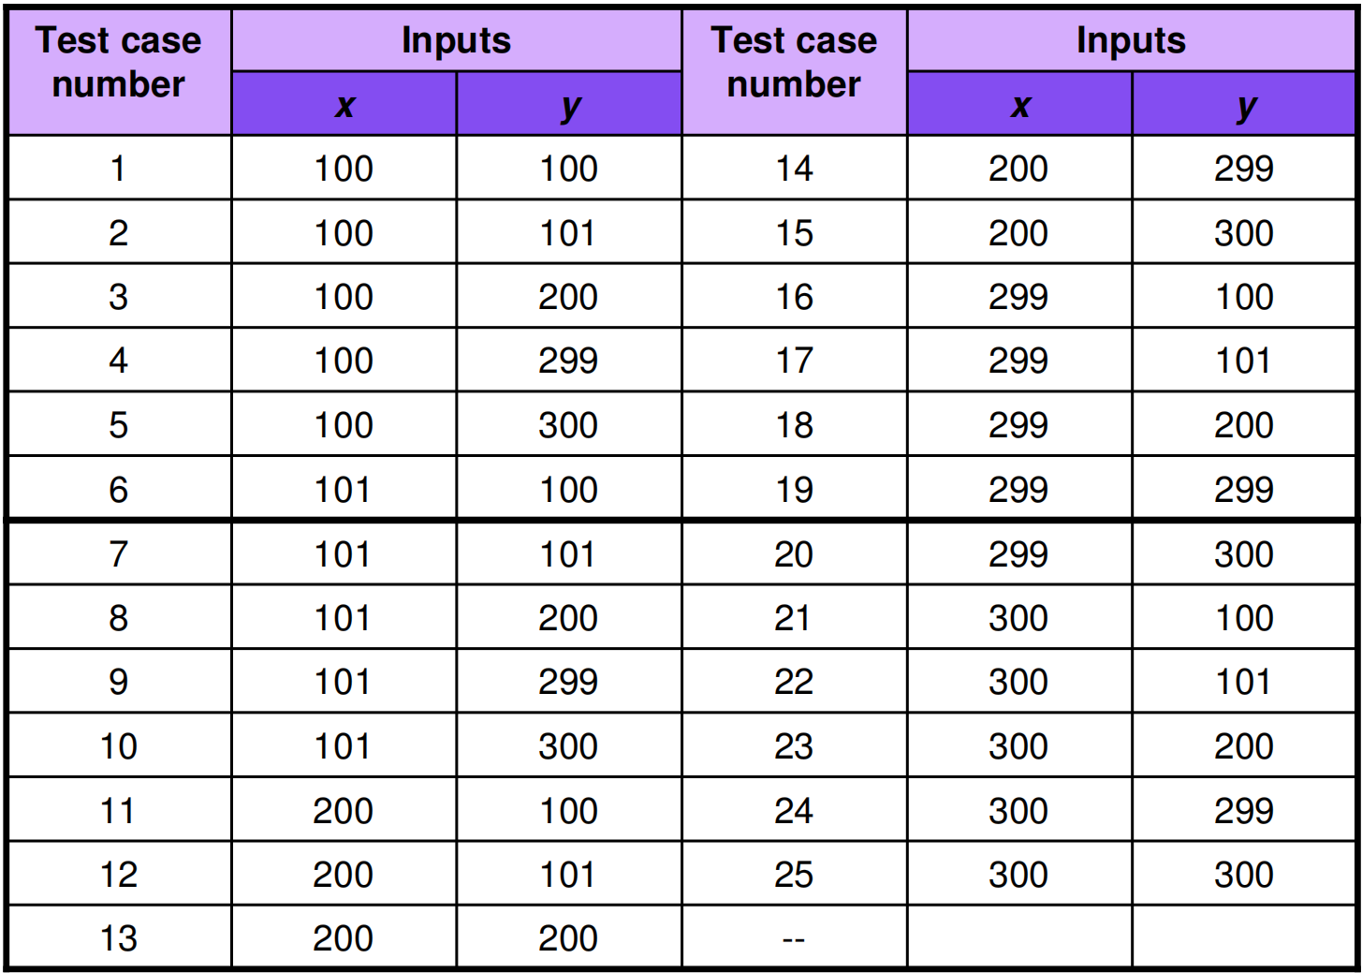
Table: Worst cases test inputs for two variables example

Slide 16
Example 8.4
Consider the program for the determination of nature of roots of a quadratic equation as explained in example 3.1. Design the Robust test case and worst test cases for this program.

Slide 17
Solution
github (robust_test_case.md)

Slide 18
Example 8.5: Home Work
Consider the program for the determination of previous date in a calendar as explained in example 3.3. Design the robust and worst test case for this program

Slide 19
Thank you for your attention!

